Slide 1

Drought
Types
Effect of water deficit on physio-morphological characteristics of the plants,
Delivered by
Dr. Ravi Kumar
Asst. Professor
Rainfed Agriculture & Watershed Management Dr. Ravi Kumar

Slide 2
Objective:-
Tell the soil and climatic conditions prevalent in rainfed areas.
Interpret various water harvesting techniques and their efficient utilization.
Apply contingent crop planning for aberrant weather conditions.
Examine the seasonal rainfall and different types of watershed and its components.
Select soil and water conservation techniques to avoid their losses.

Slide 3
Introduction
Low rainfall or failure of monsoon rain is a recurring feature in India.
This has been responsible for droughts and famines.
The word drought generally denotes scarcity of water in a region.
However, aridity and drought are due to insufficient water, aridity is a permanent climatic feature and is the culmination of a number of long-term processes.
However, drought is a temporary condition that occurs for a short period due to deficient precipitation for vegetation, river flow, water supply and human consumption.
Drought is due to anomaly in atmospheric circulation.

Slide 4
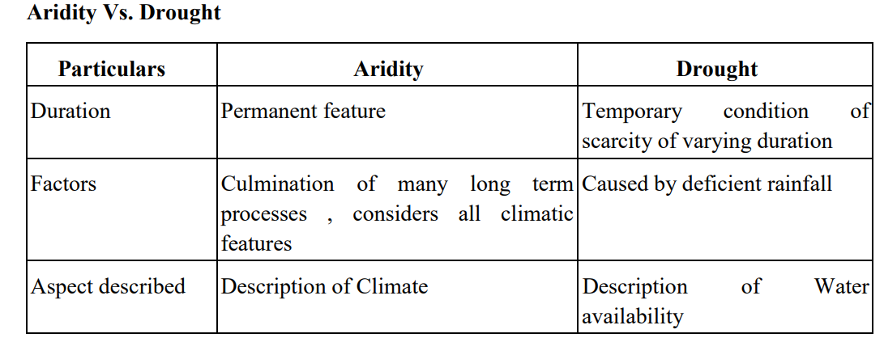

Slide 5
Definition of drought
There is no universally accepted definition for drought.
Early workers defined drought as prolonged period without rainfall.
According to Ramdas (1960) drought is a situation when the actual seasonal rainfall is deficient by more than twice the mean deviation.
American Meteorological Society defined drought as a period of abnormally dry weather sufficiently prolonged for lack of water to cause a severe hydrological imbalance in the area affected.

Slide 6
Prolonged deficiencies of soil moisture adversely affect crop growth indicating incidence of agricultural drought. It is the result of imbalance between soil moisture and evapo-transpiration needs of an area over a fairly long period so as to cause damage to standing crops and to reduce the yields.
The irrigation commission of India defines drought as a situation occurring in any area where the annual rainfall is less than 75% of normal rainfall.

Slide 7
Criteria of Drought:
NCA (National Commission on Agriculture ,1976) Agricultural drought as an occasion when at least four consecutive weeks receive rainfall half of the normal (normal rainfall being 5 mm or more) during the kharif crop season
Drought areas: Regions which experienced drought in more than 20 per cent of years
Chronic drought areas: Regions which experienced drought in more than 40 per cent of the years

Slide 8
Drought free period: When cumulative Active Evaporation curve is above cumulative Passive Evaporation/2 curve
Moderate drought period: When cumulative AE curve lies b/w cumulative PE/2 and PE/4 curves.
Severe drought period: When cumulative AE curve is below cumulative PE/4 curve

Slide 9
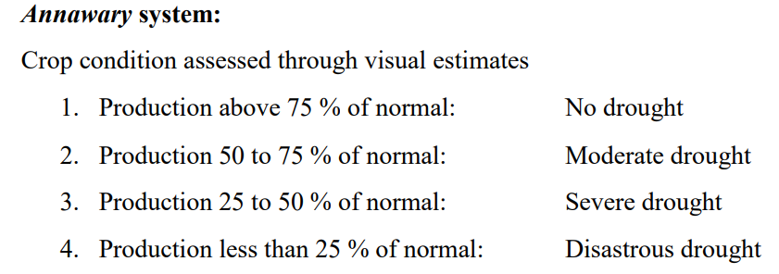

Slide 10
Classification of drought
Drought can be classified based on duration, nature of users, time of occurrence and using some specific terms
Based on duration
Permanent drought:
This is characteristic of the desert climate where sparse vegetation growing is adapted to drought and agriculture is possible only by irrigation during entire crop season.

Slide 11
Seasonal drought:
This is found in climates with well defined rainy and dry seasons. Most of the arid and semiarid zones fall in this category. Duration of the crop varieties and planting dates should be such that the growing season should fall within rainy season.
Contingent drought:
This involves an abnormal failure of rainfall. It may occur almost anywhere especially in most parts of humid or sub humid climates. It is usually brief, irregular and generally affects only a small area.
Invisible drought:
This can occur even when there is frequent rain in an area. When rainfall is inadequate to meet the evapo-transpiration losses, the result is borderline water deficiency in soil resulting in less than optimum yield. This occurs usually in humid regions.

Slide 12
Based on relevance to the users (National Commission on Agriculture,1976)
Meteorological drought: It is defined as a condition, where the annual precipitation is less than the normal over an area for prolonged period (month, season or year).
b) Atmospheric drought: It is due to low air humidity, frequently accompanied by hot dry winds. It may occur even under conditions of adequate available soil moisture. It refers to a condition when plants show wilting symptoms during the hot part of the day when transpiration exceeds absorption temporarily for a short period. When absorption keeps pace with transpiration the plants revive. (Mid day wilt).

Slide 13
c) Hydrological drought: Meteorological drought, when prolonged results in hydrological drought with depletion of surface water and consequent drying of reservoirs, tanks etc. It results in deficiency of water for all sectors using water. This is based on water balance and how it affects irrigation as a whole for bringing crops to maturity.
d)Agricultural drought (soil drought): It is the result of soil moisture stress due to imbalance between available soil moisture and evapotranspiration of a crop. It is usually gradual and progressive. Plants can therefore, adjust at least partly, to the increased soil moisture stress. This situation arises because of scanty precipitation or its uneven distribution in both space and time.

Slide 14
Relevant definition of agricultural drought appears to be a period of dryness during the crop season, sufficiently prolonged to adversely affect the yield.
The extent of yield loss depends on the crop growth stage and the degree of stress.
It does not begin when the rain ceases, but actually commences only when the plant roots are not able to obtain the soil moisture rapidly enough to replace evapo-transpiration losses.

Slide 15
Based on time of occurrence
a) Early season drought: It occurs due to delay in onset of monsoon or due to long dry spells after early sowing
b) Mid-season drought: Occurs due to long gaps between two successive rains and stored moisture becoming insufficient during the long dry spell.
c) Late season drought: Occurs due to early cessation of rainfall and crop water stress at maturity stage.

Slide 16
Other terms to describe drought
a) Relative drought: The drought for one crop may not be a drought situation for another crop. This is due to mismatch between soil moisture condition and crop selection. For eg. A condition may be a drought situation for growing rice, but the same situation may not be a drought for growing groundnut.
b) Physiological drought: Refers to a condition where crops are unable to absorb water from soil even when water is available, due to the high osmotic pressure of soil solution due to increased soil concentration, as in saline and alkaline soils. It is not due to deficit of water supply.

Slide 17
Periodicity of drought
The Indian Meteorological Department examined the incidence of drought for the period from 1871 to 1967, utilizing the monthly rainfall of 306 stations in the country. It was seen that during 1877, 1899, 1918 and 1972 more than 40 per cent of the total area experienced drought. General observation on the periodicity of drought in respect of different meteorological sub divisions of India is given below.

Slide 18
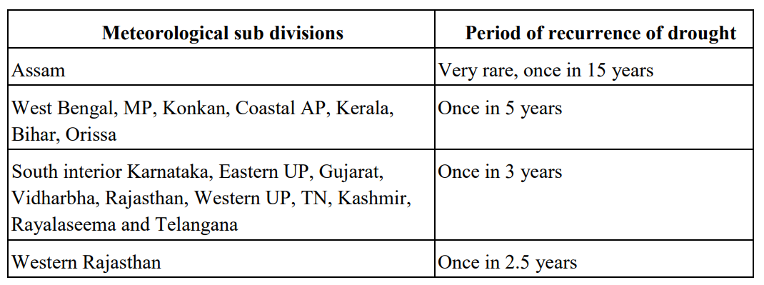

Slide 19
Important causes for agricultural drought are
• Inadequate precipitation
• Erratic distribution
• Long dry spells in the monsoon
• Late onset of monsoon
• Early withdrawal of monsoon
• Lack of proper soil and crop management

Slide 20
Effect of drought/water deficit on physio-morphological characteristics of plants Effect on water deficit on crop
a) Water relations: Alters the water status by its influence on absorption, translocation and transpiration. The lag in absorption behind transpiration results in loss of turgor as a result of increase in the atmospheric dryness.
b) Photosynthesis: Photosynthesis is reduced by moisture stress due to reduction in Photosynthetic rate, chlorophyll content, leaf area and increase in assimilates saturation in leaves (due to lack of translocation).

Slide 21
c) Respiration: Increase with mild drought but more serve drought lowers water content and respiration.
d) Anatomical changes: Decrease in size of the cells and inter cellular spaces, thicker cellwall, greater development of mechanical tissue. Stomata per unit leaf tend to increase.
e) Metabolic reaction: All most all metabolic reactions are affected by water deficits.

Slide 22
f) Hormonal Relationships: The activity of growth promoting hormones like cytokinin, gibberlic acid and indole acetic acid decreases and growth regulating hormone like abscisic acid, ethylene, etc., increases.
g) Nutrition: The fixation, uptake and assimilation of nitrogen are affected. Since dry matter production is considerably reduced, the uptake of NPK is reduced.
h) Growth and Development: Decrease in growth of leaves, stems and fruits. Maturity is delayed if drought occurs before flowering while it advances if drought occurs after flowering.

Slide 23
Reproduction and grain growth:
Drought at flowering and grain development determines the number of fruits and individual grain weight, respectively.
Panicle initiation in cereals is critical while drought at anthesis may lead to drying of pollen.
Drought at grain development reduces yield while vegetative and grain filling stages are less sensitive to moisture stress.

Slide 24
j) Yield:
The effect on yield depends hugely on what proportion of the total dry matter is considered as useful material to be harvested.
If it is aerial and underground parts, effect of drought is as sensitive as total growth.
When the yield consists of seeds as in cereals, moisture stress at flowering is detrimental.
When the yield is fiber or chemicals where economic product is a small fraction of total dry matter moderate stress on growth does not have adverse effect on yields.

Slide 25
Thank You
Rainfed Agriculture & Watershed Management Dr. Ravi Kumar

